Slide 1
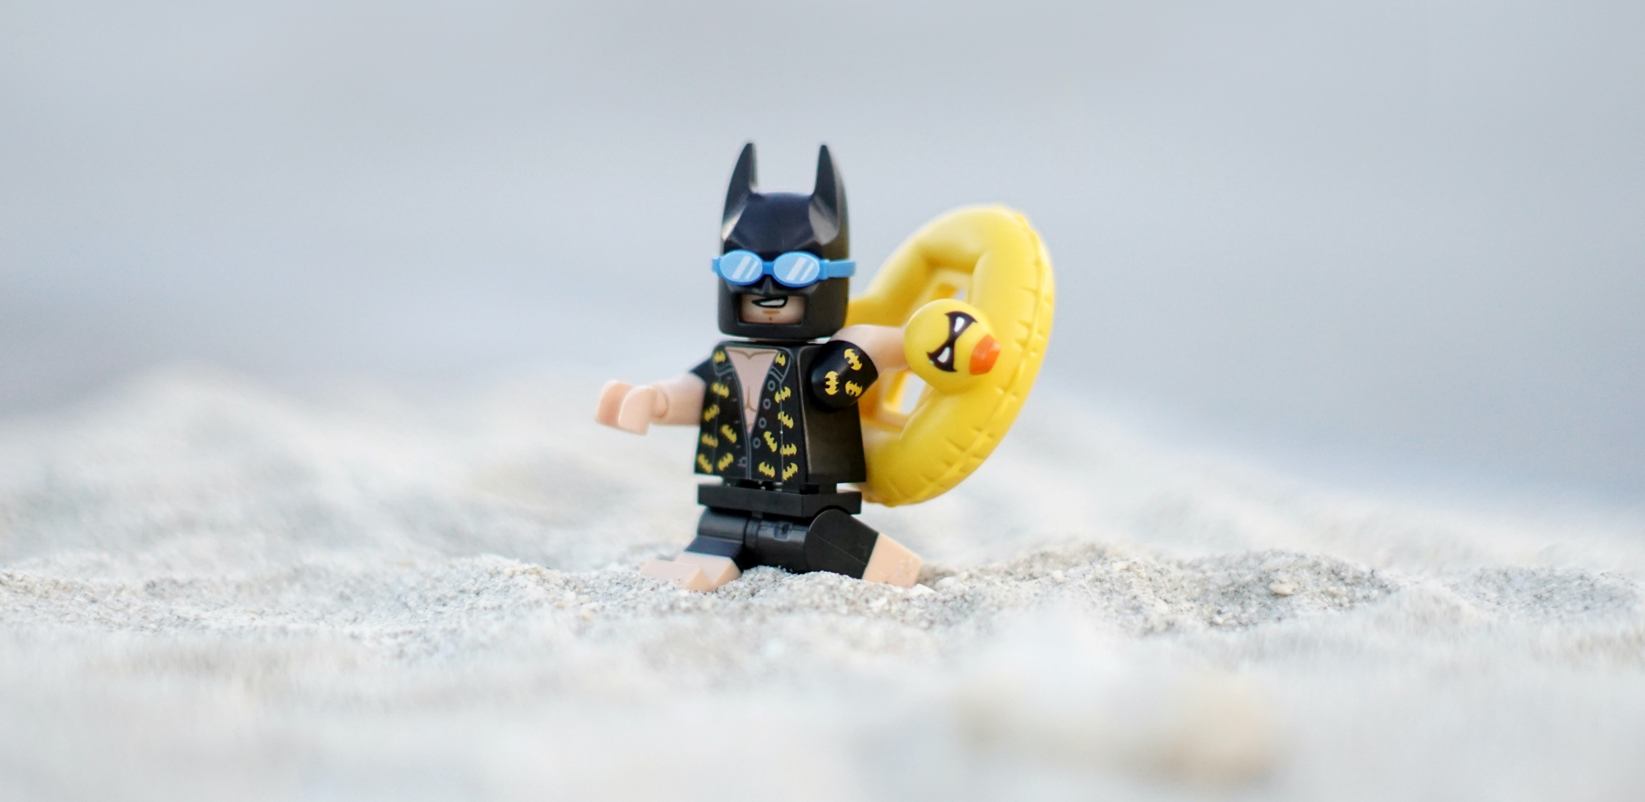


ARE YOU READY TO IGNITE YOUR QUIRKY WORK FUN SIDE?
We are searching for someone extra special to join our fabulous team
We are proud to be a Consultancy where #itsallaboutthepeople!
Our vibrant, nurturing and ‘work hard, play hard’ culture along with our unique philosophy to enable business growth through great people management practice makes us to stand out from the rest in every way…
We continuously deliver nothing other than the best when proactively producing the highest standards of quality services to our Public Sector, Not for Profit and Small/Medium sized Private Sector clients.
Our values to actively listen, understand, take the right action and achieve the right results are engrained in all we do.
As a Junior HR Consultant with positive work ethics and high levels of resilience and agility, you will need to:
Work autonomously with accountability
Have a genuine nature to engage and celebrate success as part of our close working supportive team
Be CIPD level 3 qualified or demonstrate equivalent experience
Show your exceptional people skills and ability to be responsive and enthusiastic when meeting the various HR demands and challenges of today’s times
Support a wide range of geographically based clients that you will need to travel to, when not working remotely or being based in our offices.
If your ways of working resonate with ours, and you relish in there never being a dull moment, if you thrive from working at pace across a diverse spectrum of HR and business activity, are meticulous, exceptional at multitasking, and provide outputs through being methodical and super organised, then you’ll love working with us!
In return You HR offers the best perks, a competitive salary and great opportunities to flourish and grow as an HR Pro!
Are you ready to become part of the You HR Consultancy family?
What you need to do:
Tell us about You! This is a permanent full time opportunity, however, You HR is always open to flexible working opportunities, so tell us what you are looking for and send us your CV with a supporting statement outlining why you are applying for our Junior HR Consultant role – email: gemma@youhr.co.uk by 13th November.

